Slide 1
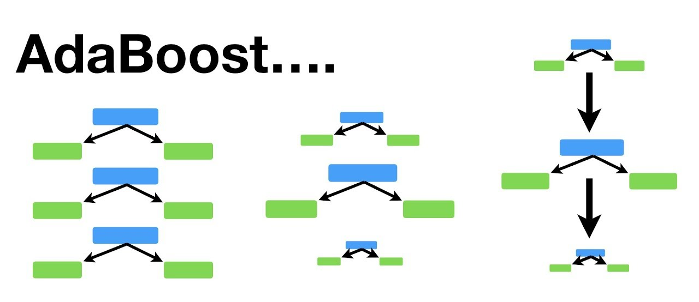
1. AdaBoost (Adaptive Boosting)
"Learns from mistakes by increasing attention to them."
Starts with a simple model.
Increases weight on wrongly predicted samples.
Next models try harder to get those right.
Good for: Clean, small datasets.
Downside: Struggles with noisy data.

Slide 2
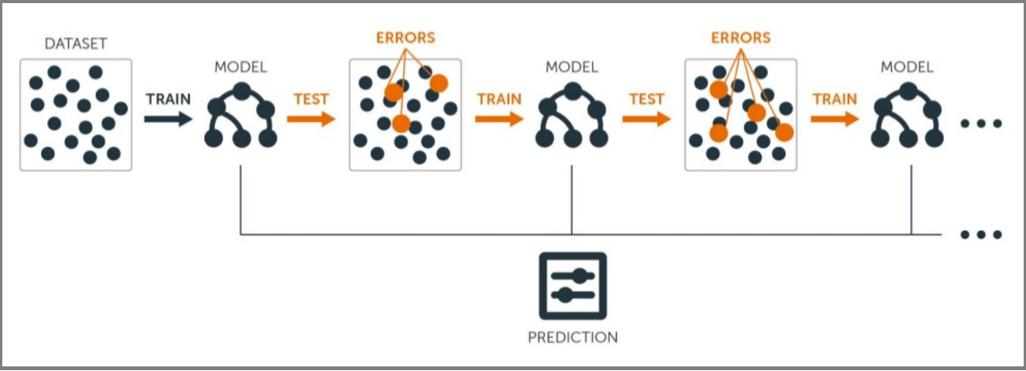
2. Gradient Boosting (GBM)
Fixes errors by following the direction of the gradient.
Fits a model to residuals (errors) from the previous one.
It corrects mistakes step by step.
More flexible than AdaBoost.
Good for: Most real-world regression/classification tasks.
Trade-off: Slower training compared to newer methods.

Slide 3
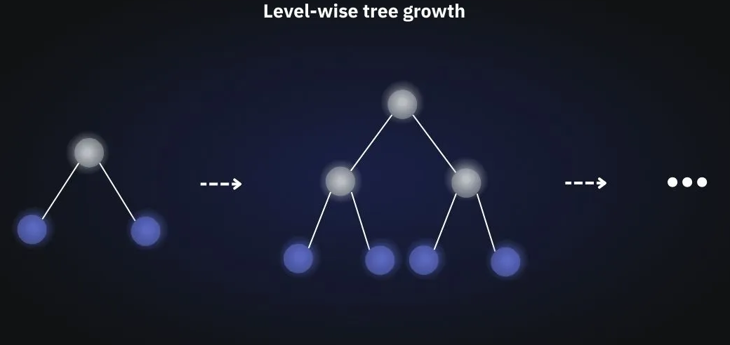
3. XGBoost (Extreme Gradient Boosting)
A faster, smarter version of Gradient Boosting.
Adds regularization to avoid overfitting.
Supports parallelization and missing values.
Good for: Tabular data, when performance and speed matter.

Slide 4
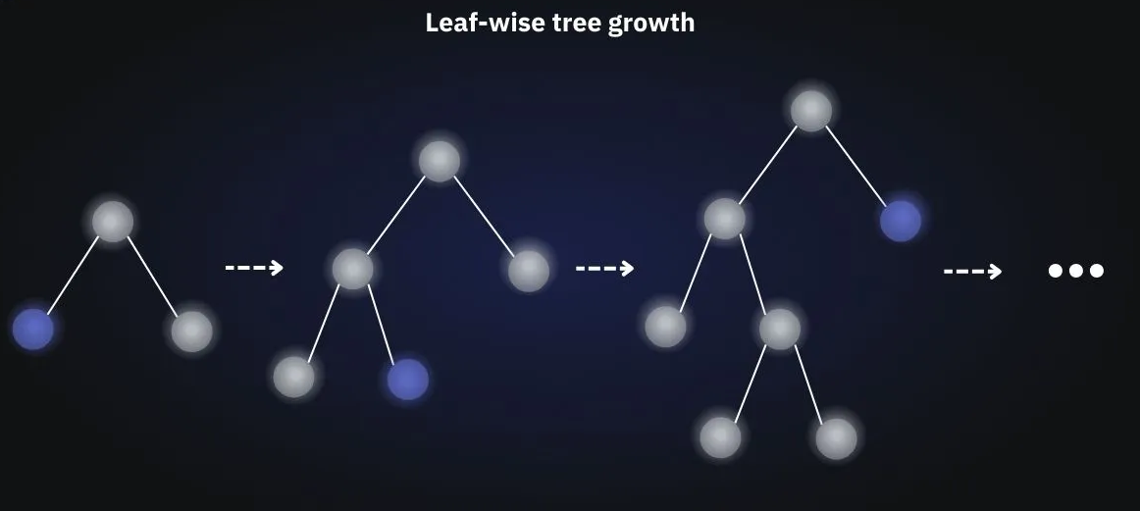
4. LightGBM (Light Gradient Boosting Machine)
Grows trees differently for ultimate speed.
Uses leaf-wise growth (vs level-wise in others).
Uses histograms to speed up calculation.
GPU support, huge datasets, blazing fast.
Good for: Large-scale data, production systems.
Caution: Can overfit small datasets if not tuned.
(overfitting is when a model becomes too tailored to the training data, losing its ability to generalize to new examples.)

